Slide 1
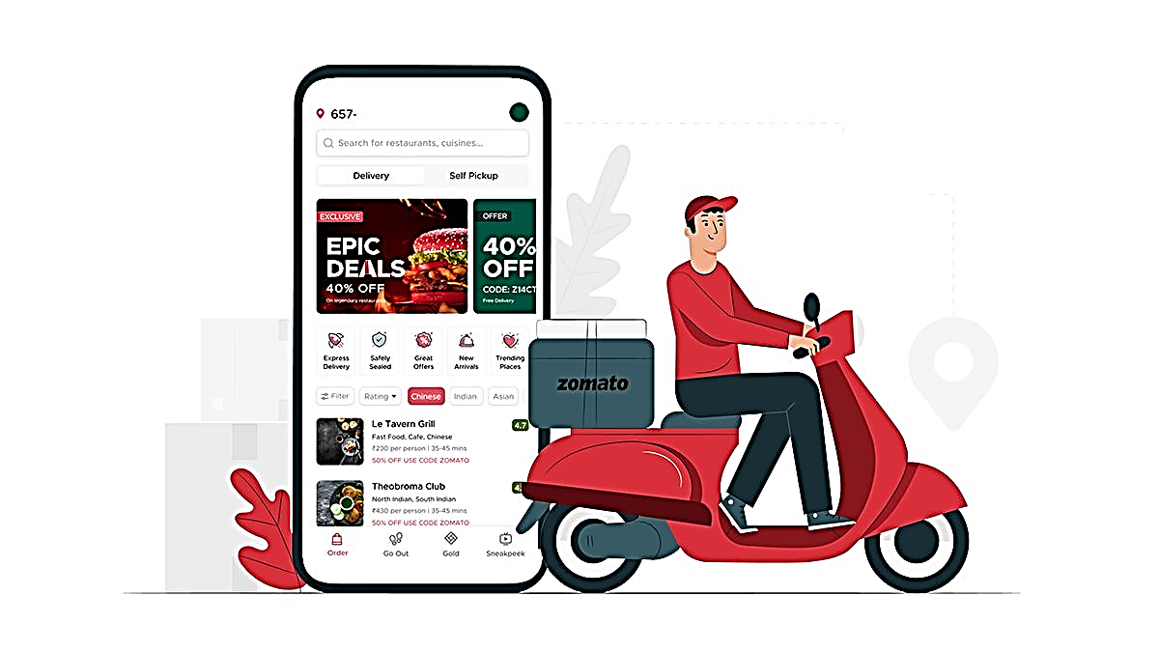
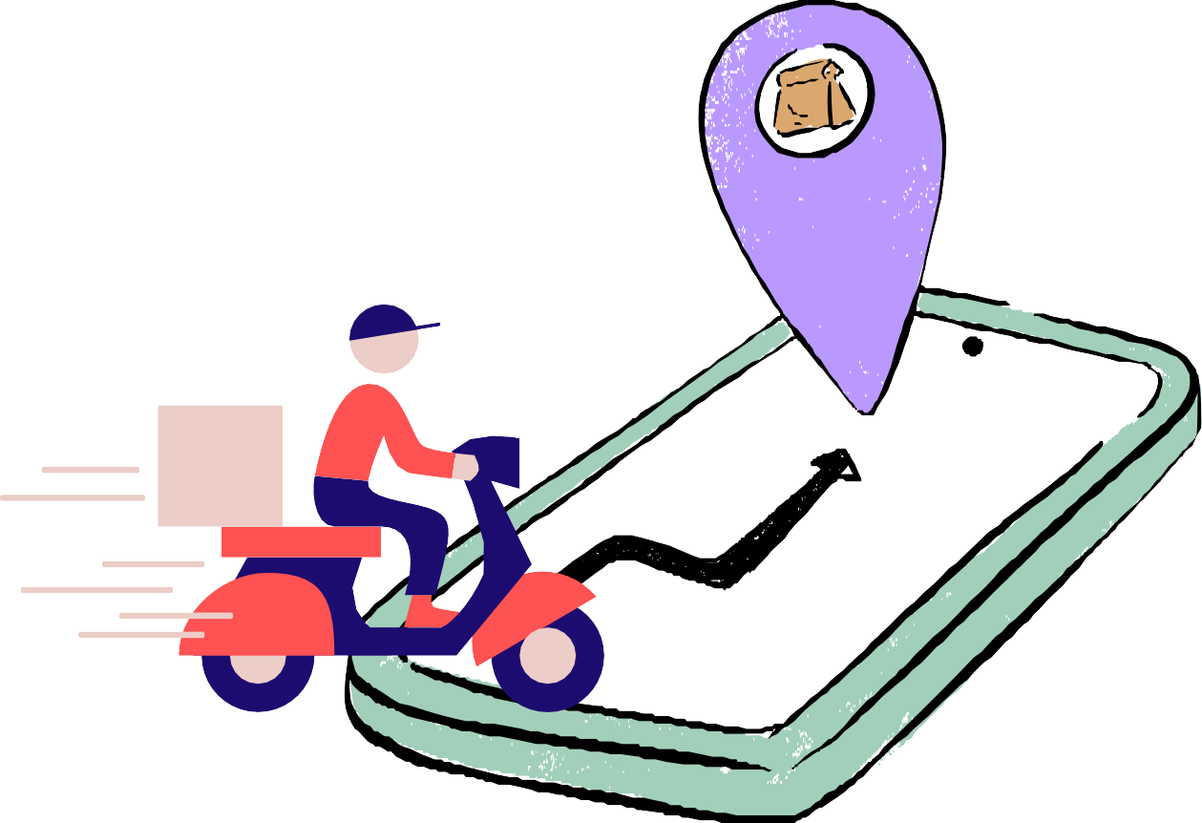

ZOMATO ~ a brand, legend & saviour
"better food for more people"
Milestone 2: Increase the number of the customer, text reviews on Zomato for the Food Delivery vertical.
Impact mapping, user research and finding the true problem
Pritam Prakash , Nit Rourkela

Slide 2

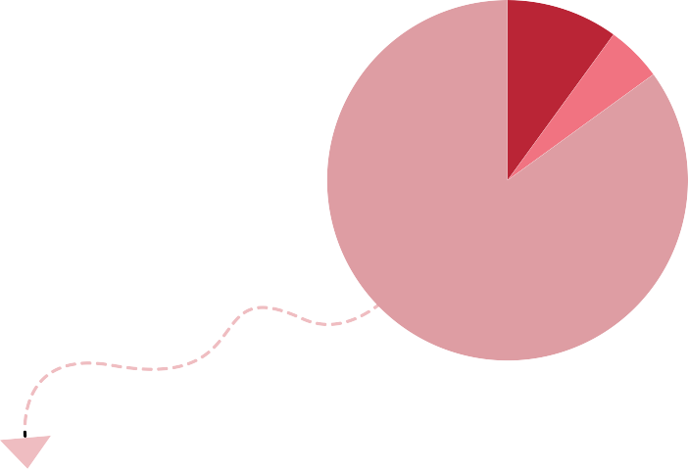



User Segmentation (Impact Mapping)
Customers who order <=4 orders/month (based on membership)
ZGold Members who order <=4 order/month
Only rating reviewers
10% 0.6624 M
MTC (monthly transacting customers
18.4 M
>4
40%
Non ZGold 40%
7.36 M
2.94 M
Avg. number of Orders placed month
63.47 M
6.624 M ZGold
60%
6.624 M
11.04 M
<=4
60%
Non-Reviewers
^{85%} 5.6304 M
Avg. number of orders placed/customer/ month
Customers based on Avg. # of orders/month
Currrent v/s potential only rating reviewers in ZGold members ordering <=4 orders/month
0.6624 M
Assumptions
Customers ordering <=4 orders/month are 60% of MTC
~ 4
Total Text 2.78208 M
Reviews at 14% =
Potential Only rating reviewers who can write Text Reviewers; Increased by
^{4% =} 0.92736 M
10%
Of the above, Zomato Gold members are 60%
40%
14%
6.624 M
Of the above ZGold members ordering <=4 orders/month (Avg. taken ~3 for this segment):
Text Reviewers are 5%
Reviwers who only rate are 10%
Non-Reviewers are 85%
Target Customers
Potential ZGold ordering <=4 orders/month & are only Rating Reviewers = 0.6482 M
Average # of Orders placed per month (3)*
# of Customers from this segment = Tot. Text Reviews by this segment
Hypothesis:
What’s stopping them from writing a text review?
They find it too boring, time-consuming and a tiring task
Total Text 1.9872 M
Reviews at 10% =
Why is this impactful?
ZGold membership comprises 40% of GOV in 2023 with its # members grown by 90% since 2022
Increased engagement with the app by examining reviews on meals/restaurants & making informed decisions
Customers who spend time rating their orders are the reviewers who have the potential to write a review with a little bit of push/motivation.
Never comes to their head about writing a text review
They’re lacking the motivation/trigger to write a review and only a 4% increment in their segment can help us get 40% growth in the number of text reviews.
No value gained out of it; improvement in food, incentives,
Customers will feel valuable after seeing improvement in food
Overwhelmed with other apps causing distraction
Restaurants will show improvement in their food & growth in revenue

Slide 3



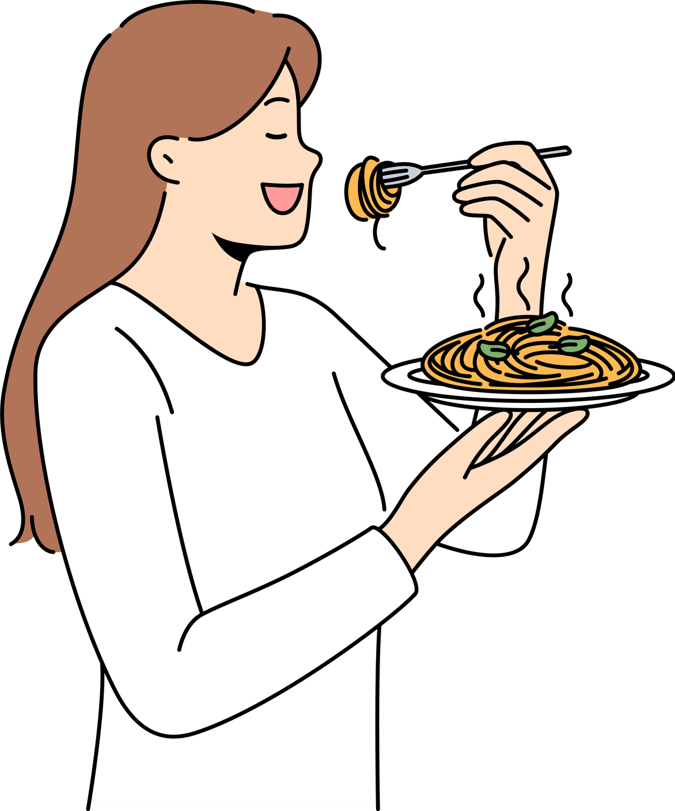

Key Insights
User Research: 48 Surveys & 5 User Interviews
62.5%
ZGold
Members
54.16%
Order for Self,
Friends & Fam
There’s not much time in their lives or they’re just involved/engaged in activities building more value in their lives than dropping a review
79.16%
Age: 20-30
47.9%
Avg. # Order /
Month: 2-5
64.5%
Reviewers
(text/only rate)
60.41%
Only Rate
an Order
The time between placing the order and receiving is spent
continuing their last task.
39.5% of them find text reviewing to be a time consuming task
Job to accomplish before placing an order is Cravings with 45.8% of total
29.16% of them expect to receive incentives after writing a text review and 43.75% expect improvement in food or other services
They come back to the app to track their orders every now & then.
Ratings mentioned on food strengthen their decision-making process.
32.1% of people are who order <=5 times a month, are Zomato gold members & who rate an order.
Only 39.58% would end up writing a text review and that’s the case if it’s a Avg - Medium/Bad Order
Interaction is the trigger for them to rate or drop a review (if they ever do): Interaction with the delivery partner or customer support resolution makes them drop a review for the respective people.
Pain Points
Reviewing at other places is a function of passion, experience & way of consuming that product/service during their leisure time.
No value is gained out of it like incentives, a valuable gesture in-person or even validation for their loyalty.
It takes time to think & write a review, therefore never a first thought or even an ‘important’ task for them
It’s an extra added step, takes time and bring them nothing out of it.
The times when food is exceptionally good or bad (in cases when the issue is not resolved by the restaurant or sometimes by Zomato), that’s when they drop a review.
Most of their orders are repeated orders/meals from their favorite restaurants based on their 1st impression, and they order it when they don’t have time to think about what to order or are hungry. It happens mostly on weekdays in between their office hours.

Slide 4
“Lack of emotional connection prevents them from droppinoft a revie
Problem Framing
Who is facing this problem?
Zomato Gold members
How do we know if it’s a real problem?
What is the true problem?
Customers often lack an emotional connection with the restaurants, viewing their food ordering as a routine rather than a special experience. This contributes to fewer text reviews being left, as they need to perceive something exceptional about the restaurant's service.
From the user research, it was found only a 60.41% rate on orders (not all times), and 40% don’t write a review.
Place orders <= 4 times a month
Mostly repeat an order (dish(es)) from the same place
A report states only 1.5% of orders that are rated have text reviews written for them.
Sometimes rate an order
How do we know if it’s a real problem?
What are the benefits of solving this problem?
Zomato holds a 55% share in a duopoly market, but its competitor Swiggy is rapidly growing. Swiggy's restaurants and dishes rank higher on Google searches, attracting more organic traffic. Zomato could leverage its strong review and rating system to better capture this opportunity.
Target Users
Improved Recommendations: Users get tailored suggestions based on their reviews, introducing them to new or familiar restaurants to explore.
Business Conversion & Retention: Zomato
boosts trust, user engagement, and restaurant revenue.
Restaurant Image:
In-App: Reviews build a reputation and improve quality. Organic: Word-of-mouth drives growth and customer loyalty.
Emotional Bond: Users feel loyal, making decisions easier and encouraging recommendations.

